Slide 1
LoboTime v8.1.6 Upgrade Differences Overview
Notes:
Hello everyone thank you for attending this meeting. I wanted to go over the actual LoboTime v8.1.6 upgrade differences when compared with our current version.

Slide 2
Changes from v7.0.10 to v8.1.6
Not too many changes for employees
Most of the changes were done for managers and supervisors rather than employees.
However, most changes are really a new look and feel change, but the overall process behind it is still the same.
There are new functionalities in the Quick Actions bar that doesn’t necessarily replace the previous ability, but adds more ways to complete certain actions.
Changes to the application infrastructure (Removal of Java & Flash)
Notes:
Not too many changes for employees from this upgrade in fact most of the changes you will see in this presentation are for managers and supervisors.
However, most changes are really a new look and feel change, but the overall process behind it is still the same.
Additionally, there are new functionalities that adds more ways to complete certain processes.
Changes to the application infrastructure (Removal of Java & Flash)

Slide 3
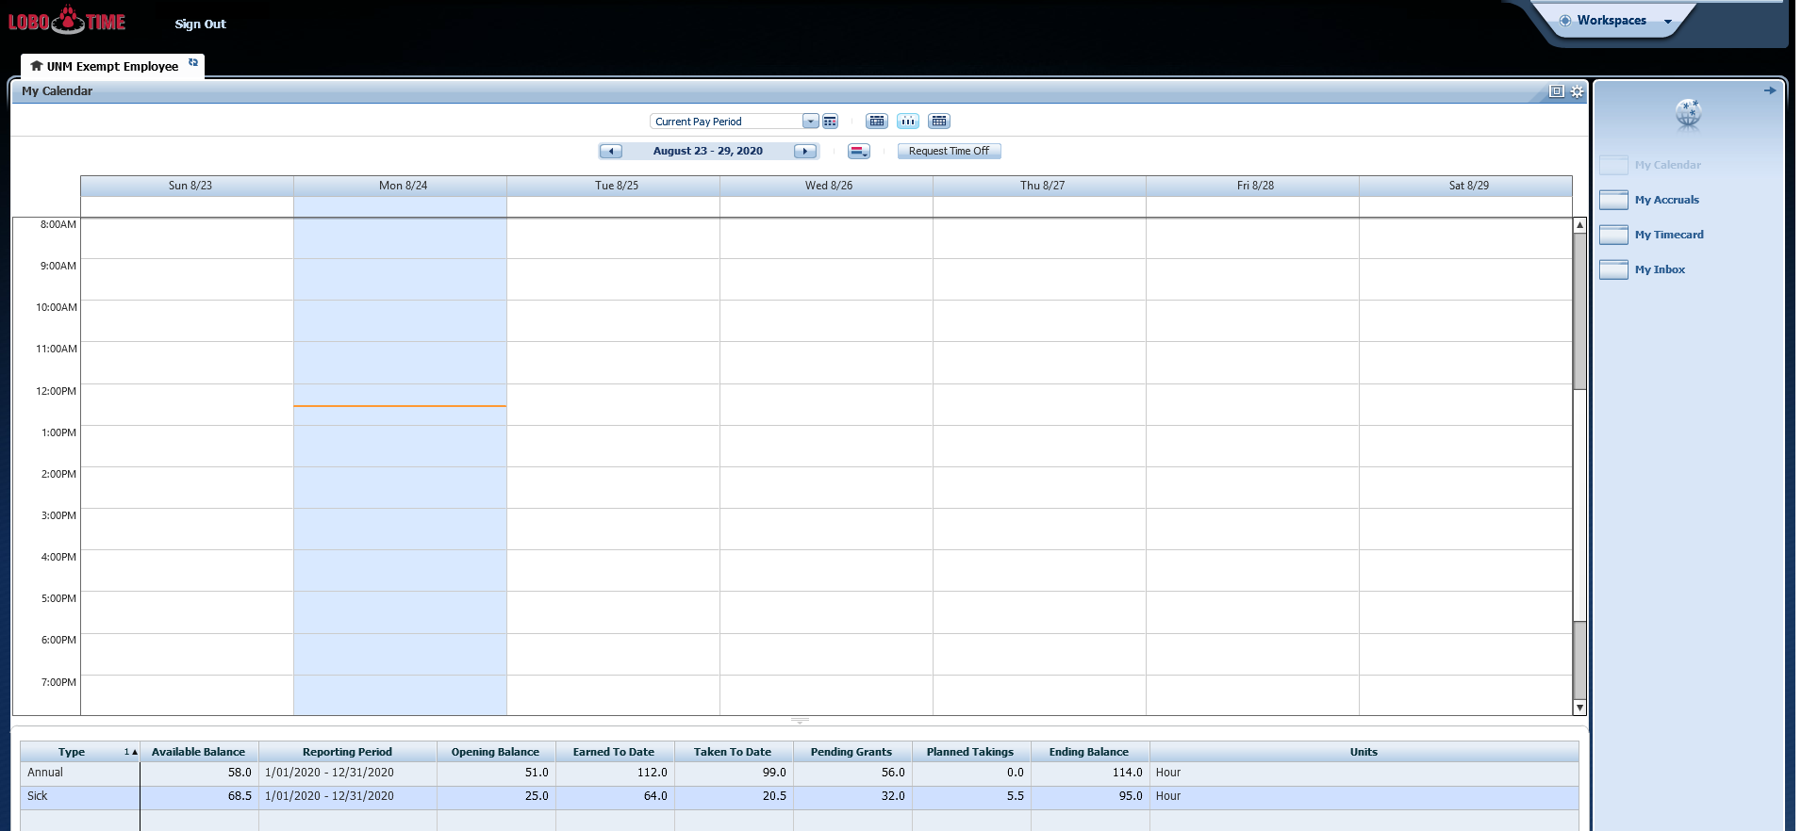
Current LoboTime – Exempt Employee Landing Page

Slide 4
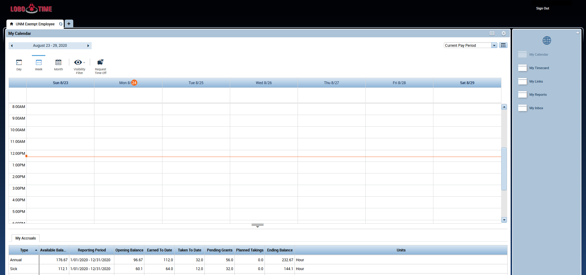
LoboTime v8.1.6 – Exempt Employee Landing Page
Notes:
As you can see when comparing between the two images that other than for a few items being moved around that most of the items are still the same.
They moved around a few things such as
Dropdown for the pay period
Calendar Week selection
Request Time Off which has also been updated with a new icon.
Day/Week/Month View are now larger buttons with text underneath them.
My Accruals is at the bottom of the page and can be used to calculate accrual totals for a future date by changing the pay period or using the calendar icon to input a date. However, Banner is still the most accurate place to go for accrual totals.

Slide 5
Current LoboTime – Non-Exempt Employee Landing Page

Slide 6
LoboTime v8.1.6 – Non-Exempt Employee Landing Page
Notes:
Similarly for the Non-Exempt Employee My Timestamp it has been relatively unchanged other than the “Record Timestamp” button being smaller now.

Slide 7
Current LoboTime – Manager Landing Page

Slide 8
LoboTime v8.1.6 – Manager Landing Page
Notes:
Not altogether a lot of changes on this landing page, however, I will go into a little more detail in the next several slides detailing the changes to the reconcile timecard functions that have a new icon/look.

Slide 9
Current LoboTime – Manager Reconcile Timecard
Notes:
Here we will be comparing the timecard, schedule, and reports button. Here they are just link/buttons located in red.

Slide 10
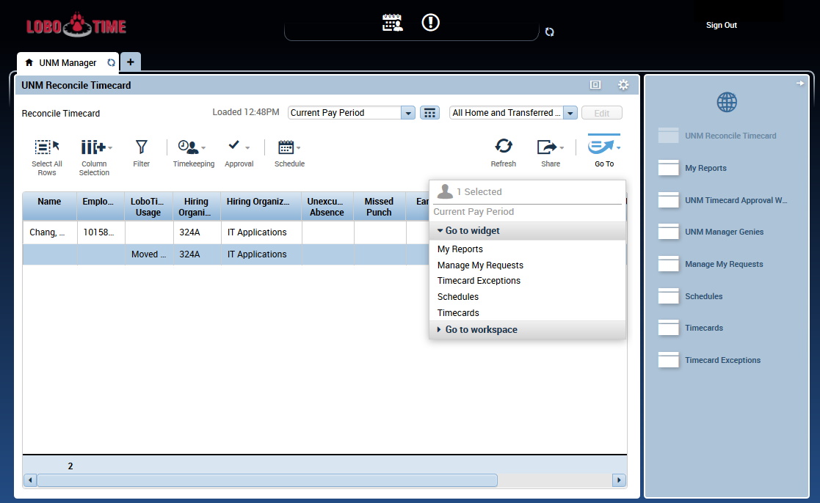
LoboTime v8.1.6– Reconcile Timecard & Go-To View
Notes:
However, in the new version:
To see employee timecards and schedules now you will have to highlight the employee and then select the “Go-To” button and select the widget you would like such as timecard, and schedules.
Utilizing the Go-To button you can also access your reports, timecard exception, or manage my requests as well, however, they are also located on the right side as links as well.
The location of the Hyperfind and Pay Period drop down box have moved from the left-center side of our current version to the right hand side in the new environment.

Slide 11
Current LoboTime – Reconcile Timecard Functions
Notes:
We will be going over the Timecard functions here and seeing how the punch, amount, schedule, approvals have been updated in the new version.

Slide 12
Current LoboTime – Reconcile Timecard Functions
Notes:
The core functions haven’t changed, but they have been replaced with a new icon.
Punch and Amount have been placed under the timekeeping icon
One thing that has changed a little bit is that the export to Excel, export to CSV, and print options have moved from the “Actions” link in our current environment to the “Share” button located on the right now.

Slide 13
Current LoboTime – Workspaces/Carousel
Notes:
Here we will be comparing the workspaces/carousel that is located in the upper right hand corner in our current environment.

Slide 14
LoboTime v8.1.6 – Workspaces/Carousel
Notes:
The workspace carousel has now been replaced in v8.1.6 by clicking on the + button next to the UNM Manager tab and then selecting UNM Exempt Employee or UNM Non-Exempt Employee.
You can now switch between your manager workspace and your employee workspace with ease.

Slide 15
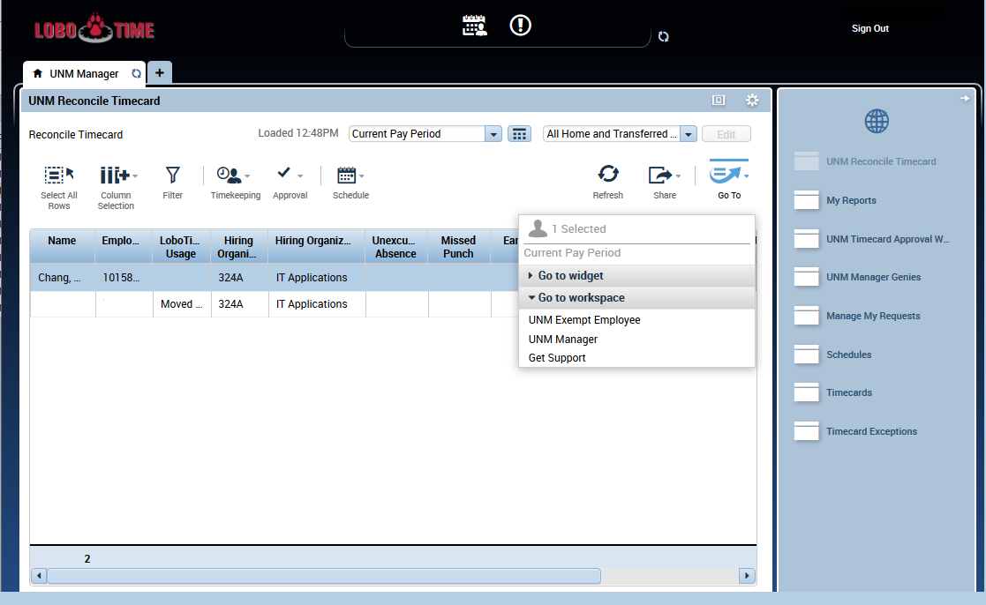
LoboTime v8.1.6– Workspaces Go-To View
Notes:
You can also access your own employee workspace or manager workspace utilizing the go-to button as well.

Slide 16
Current LoboTime – My Calendar

Slide 17
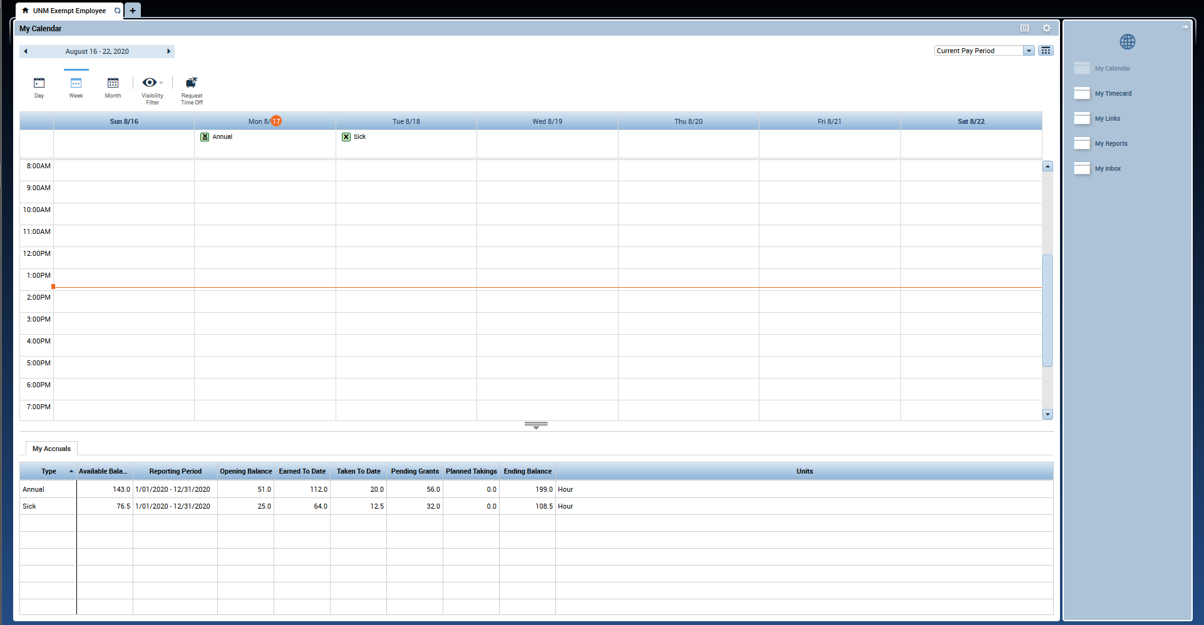
LoboTime v8.1.6 – My Calendar
Notes:
My Calendar was covered a little bit at the beginning of this slideshow when reviewing the exempt employee landing page, but the My Calendar view will be the same for both non-exempt and exempt employees.
(If Needed) Recap of changes:
They moved around a few things such as
Dropdown for the pay period
Calendar Week selection
Request Time Off which has also been updated with a new icon.
Day/Week/Month View are now larger buttons with text underneath them.
My Accruals is at the bottom of the page and can be used to calculate accrual totals for a future date by changing the pay period or using the calendar icon to input a date. However, Banner is still the most accurate place to go for accrual totals.

Slide 18
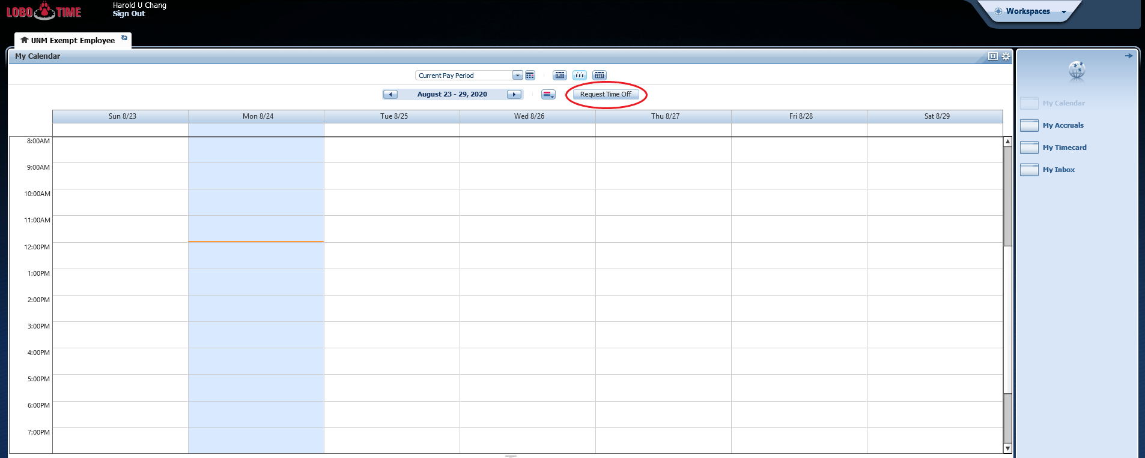
Current LoboTime – Request Time Off
Notes:
Next we will be comparing the request time off function in My Calendar. There aren’t many changes with how the request time off function works

Slide 19
New LoboTime – Request Time Off
Notes:
However, the location of the request time-off button has moved and has a new icon, but you can still access and request leave in the same manner.

Slide 20
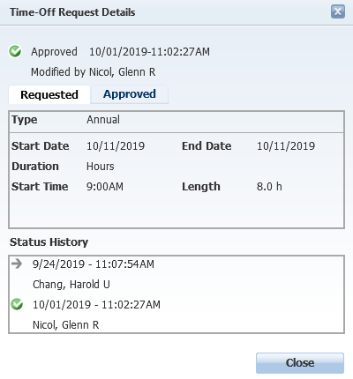
Current LoboTime – Time Off Details
Notes:
The time off details and requesting time off is relatively unchanged as you’ll see in the next slide.

Slide 21
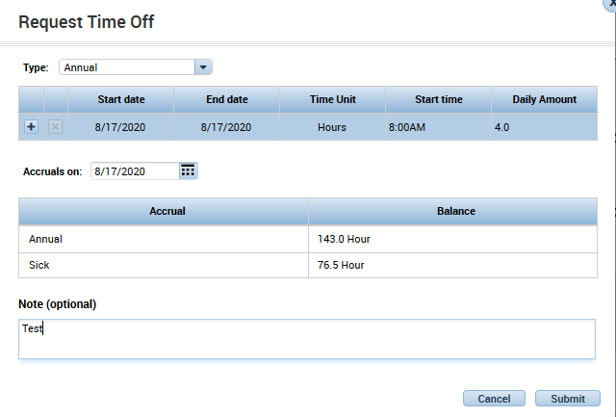
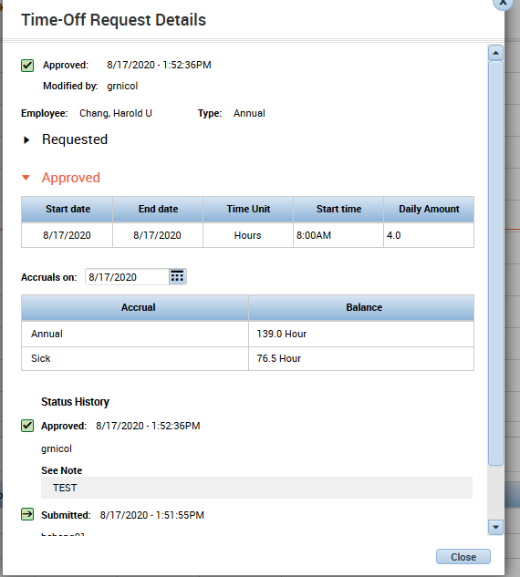
New LoboTime – Time Off Details
Notes:
As I said not much has changed here as well except for the notation of the daily amount instead of duration. There has been some confusion with our current environment relating to duration and employees putting in the total amount of hours for their multi-day leave requests. However, this has been changed so that it shows that you need to put in the daily amount of hours so if an employee is taking a week off instead of putting 40 hours there they should only put 8 hours. This has been updated in our new LoboTime version so that this might limit confusion.

Slide 22
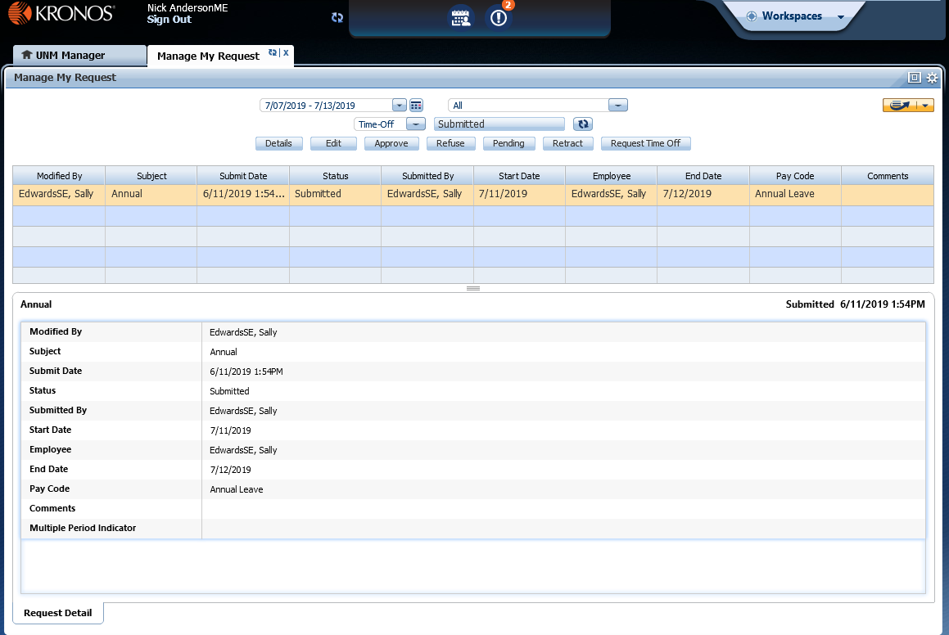
Current LoboTime – Manage My Requests
Notes:
Next we will talk about the Manager’s manage my requests

Slide 23
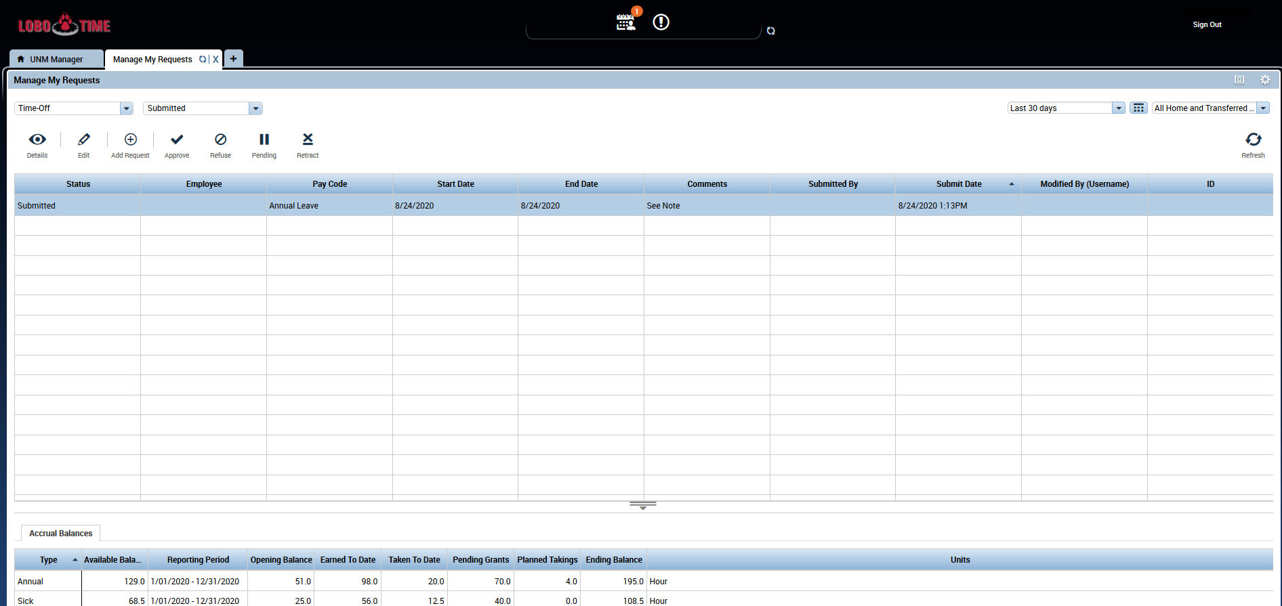
LoboTime v8.1.6 – Manage My Requests
Notes:
Within this screenshot we can see that most of the changes involve the same changes we have been seeing which revolve around updating buttons with new icons.
You are unable to see the request details at the bottom of the screen anymore instead you will see their accrual balances instead.
Similar to our current instance you can select to approve, refuse, or retract a request.
Additionally like our current environment if you actually want to edit a leave request you must do it through the approve action and updating the fields as needed there, when selecting the edit button it actually won’t let you edit the details, but just provide comments, which you can do in the approval action.

Slide 24
Current LoboTime – Timecard View - Exempt
Notes:
Next we will be comparing the exempt employee timecard view

Slide 25
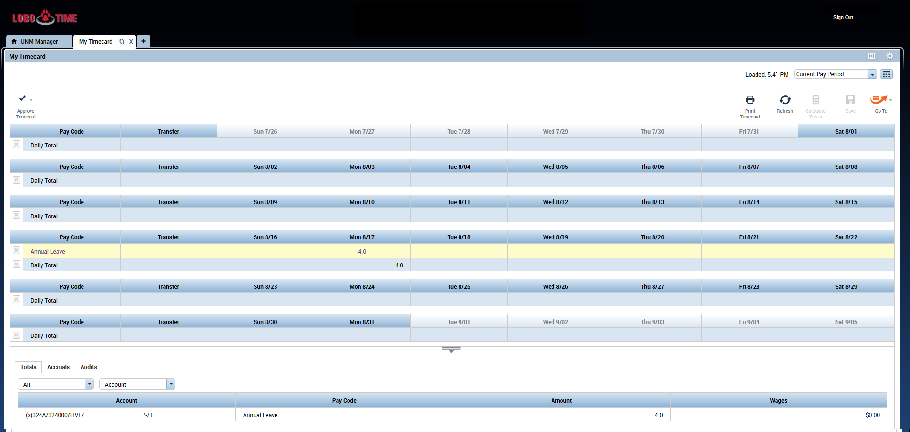
LoboTime v8.1.6 – Timecard View– Exempt
Notes:
Not much has changed with the Exempt Employee Timecard View other than the Approve Timecard button being relocated and the addition of the “Go To” button and the “Print Timecard” button.

Slide 26
Current LoboTime – Timecard View - Non-Exempt
Notes:
Here we will compare the non-exempt employee timecard view.

Slide 27
LoboTime v8.1.6 – Timecard View - Non-Exempt
Notes:
As you can see it hasn’t changed too much. The same changes that affected the exempt employees have been updated here e.g. Go-To button and Approve Timecard view.
However, if you click the view icon now you can filter your timecard for days with exceptions.

Slide 28
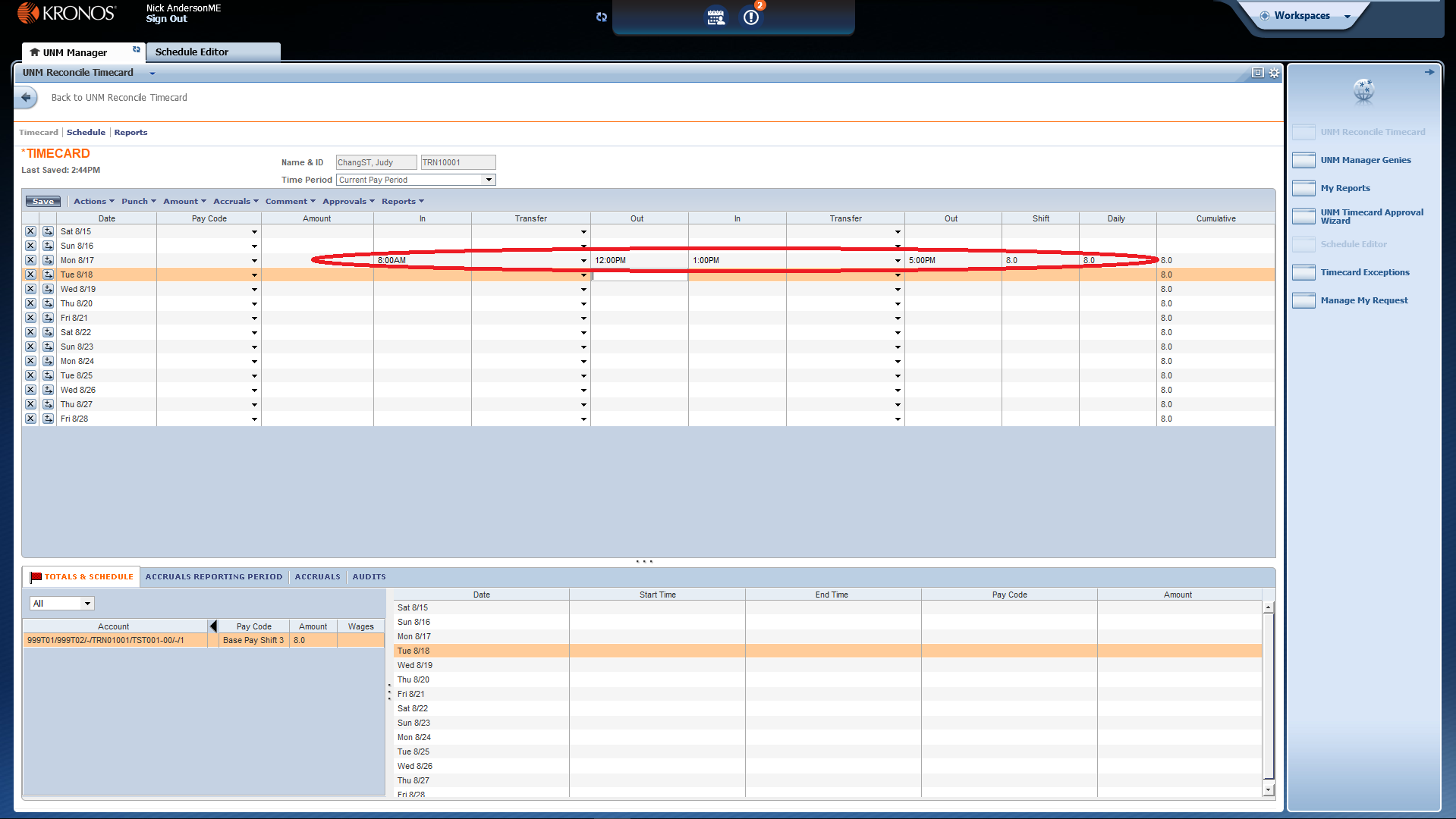
Current LoboTime – Manager Non-Exempt Employee Timecard View
Notes:
This is the current view of what a Manager sees when they got to an employee’s timecard. The red circle here will highlight the change in the version of recording punches.

Slide 29
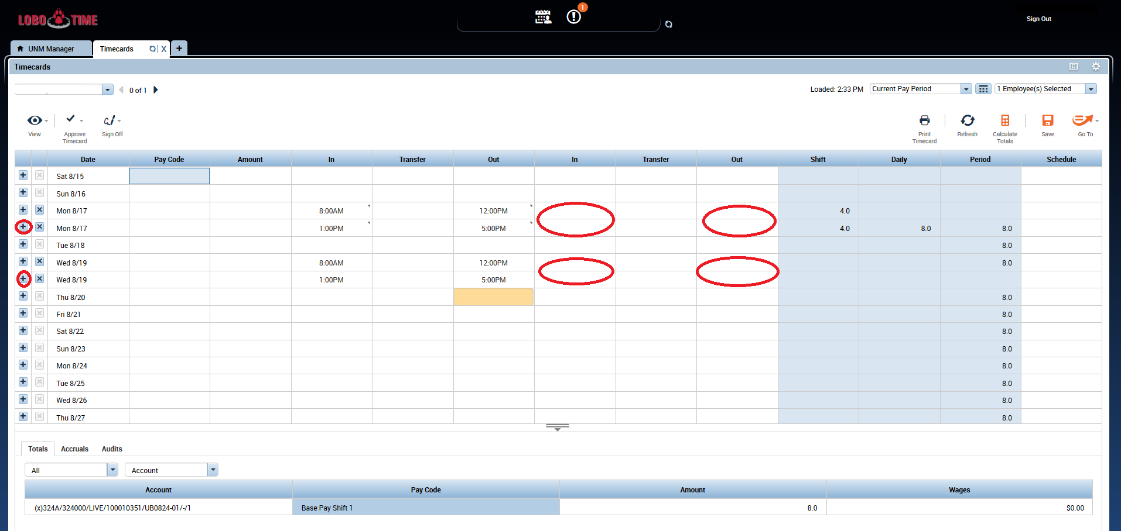
LoboTime v8.1.6 – Manager Non-Exempt Employee Timecard View
Notes:
When viewing employee’s timecards it will now show another line for each shift or clock in/clock out period instead of how in our current environment it would continue to go to the right of the original date and time instead of creating a new row for it.
You can also instead of typing in the In and Out boxes for punches insert them by pressing the + button to create another record for that specific day.

Slide 30
Current LoboTime - Approving Timecard - Exempt
Notes:
Next we will view the approving timecard function which contains a few changes as well

Slide 31
LoboTime v8.1.6 – Approving Timecard
Notes:
As you can see the Approve Timecard function has it’s own icon and has moved to the left, but the timecard approval process has not changed.

Slide 32
LoboTime v8.1.6 – Approving Timecard - Exempt
Notes:
However, once you approve your timecard the timecard should change to yellow for any dates that you have submitted leave or have holiday credit
The approval record will appear at the bottom under the audits tab and with the “Approvals/Sign-offs” drop down box.

Slide 33
LoboTime v8.1.6 – Approving Timecard – Non-Exempt
Notes:
You’ll see the same thing occur for our non-exempt employees as well except that their whole time card will be yellow once approved.
The approval will appear in the bottom under the audits tab and with the “Approvals/Sign-offs” drop down box.

Slide 34
LoboTime v8.1.6 – Manager Approving Timecard - Non-Exempt
Notes:
In the same regard manager’s approving timecards will notice that the non-exempt employee’s timecard will change to yellow as well.
The approval will appear in the bottom under the audits tab and with the “Approvals/Sign-offs” drop down box.

Slide 35
LoboTime v8.1.6 – Manager Approving Timecard - Exempt
Notes:
Once the manager approves the timecard the card should change to a yellow color.
The approval will appear in the bottom under the audits tab and with the “Approvals/Sign-offs” drop down box.

Slide 36
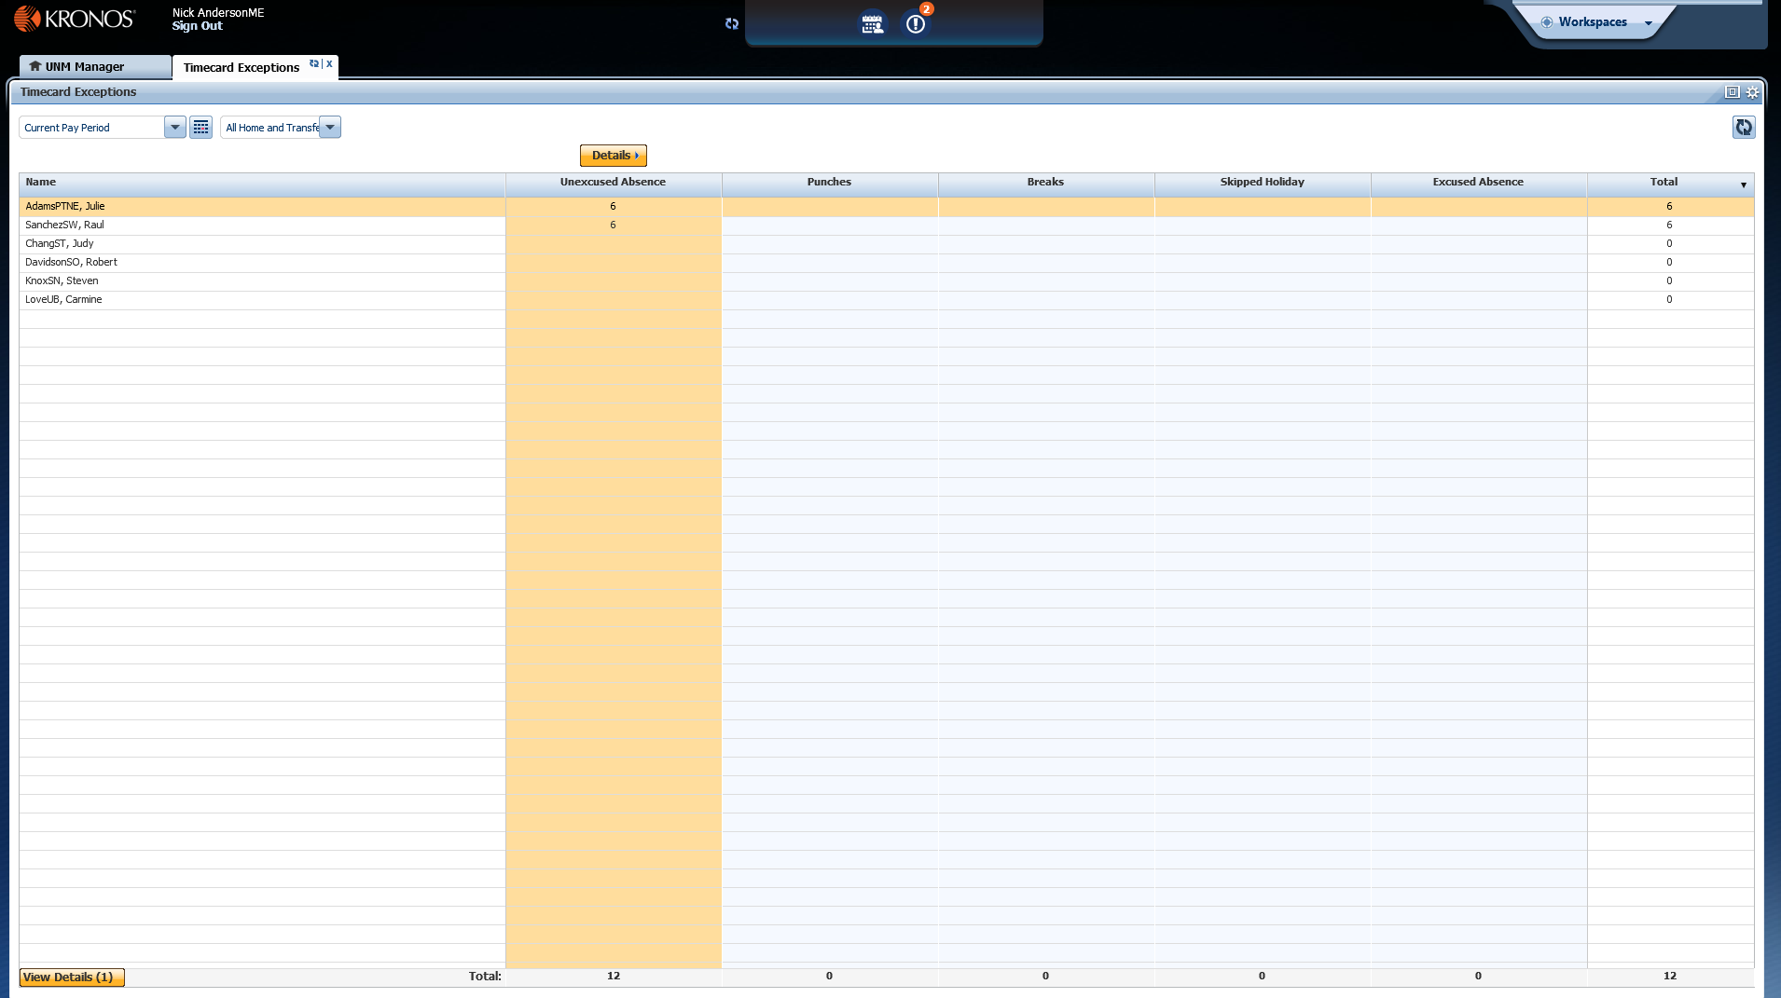
Current LoboTime Navigator - Exceptions
Notes:
Here we will compare the changes to exceptions which includes some new functions or actions that can be done.

Slide 37
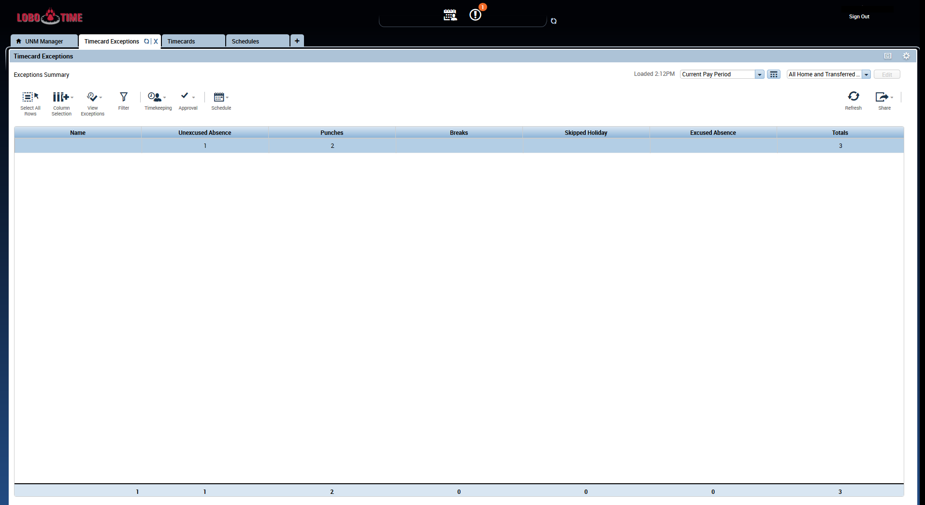
LoboTime v8.1.6 - Exceptions
Notes:
In the v8.1.6 version of LoboTime the changes here are seen within the actions that can be performed.
Under the View Exceptions button you can see specific types of exceptions similar to how it is in the current version where you could highlight over the column you wanted to view and select details.
You also have access to the timekeeping, approve, and schedule actions within this view as well so that you can complete other actions in this view as needed as well.

Slide 38
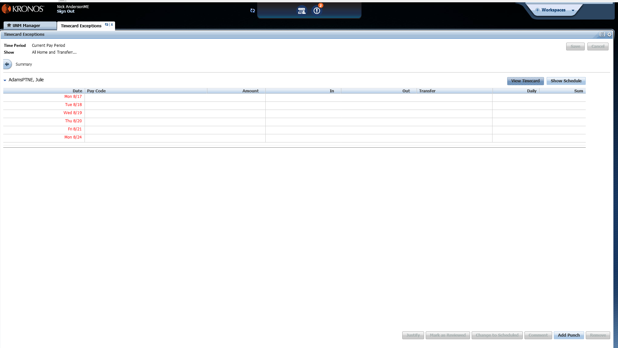
Current LoboTime Navigator – Exceptions Details
Notes:
Next is reviewing the exception details between our two versions

Slide 39
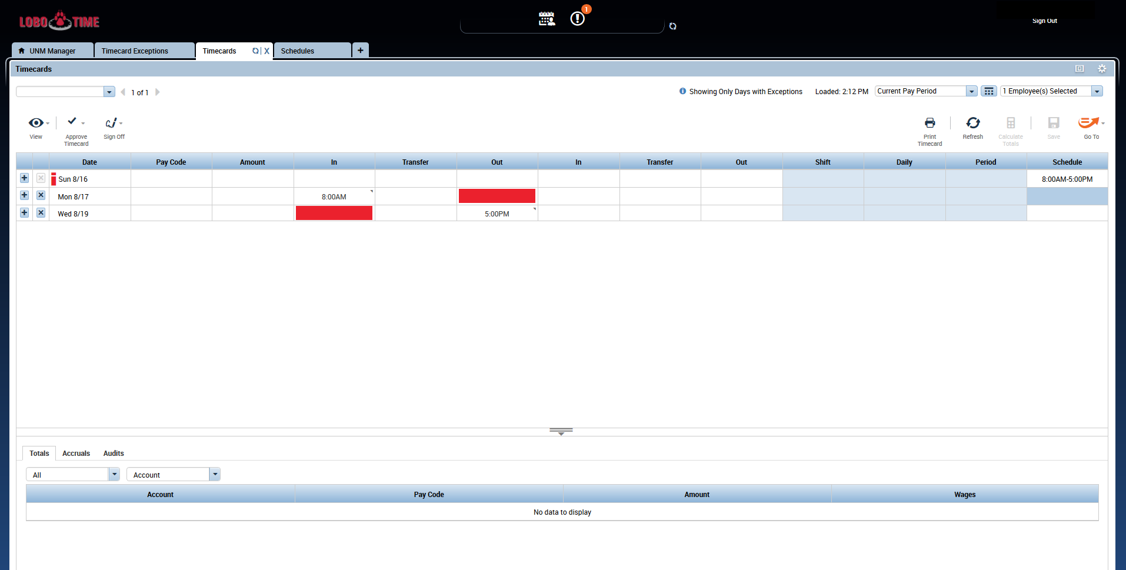
LoboTime v8.1.6– Exceptions Details
Notes:
In this new version, when you select to view the timecard exception details it will switch you to the specific employee’s timecard and only display days with exceptions.
Unfortunately, unlike in our current version you can only view one employee’s timecard exceptions at a time, however, you can scroll through them using the arrow next to the employee’s name.
They did simplify correcting these exceptions within the timecard, you can now just add in the time directly in the fields for any missed exceptions.

Slide 40
Current LoboTime – UNM Manager Genies

Slide 41
LoboTime v8.1.6 – UNM Manager Genies
Notes:
In the new version when you click on UNM Manager Genies it will automatically open up to quick find.
However, if you click the arrow next to the quickfind it will be a dropdown box with the other genies.

Slide 42
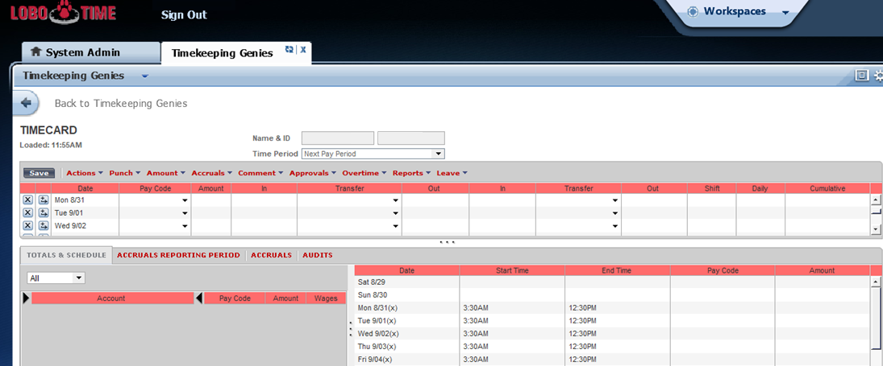
Current LoboTime - Schedule in Timecard

Slide 43
LoboTime v8.1.6 – Schedule in Timecard
Notes:
Schedules for Timecards have moved from the bottom of the page to the last column of the Timecard.

Slide 44
Current LoboTime – Schedule Editor
Notes:
Not much has changed between our current version of schedule editor compared to the newer version.

Slide 45
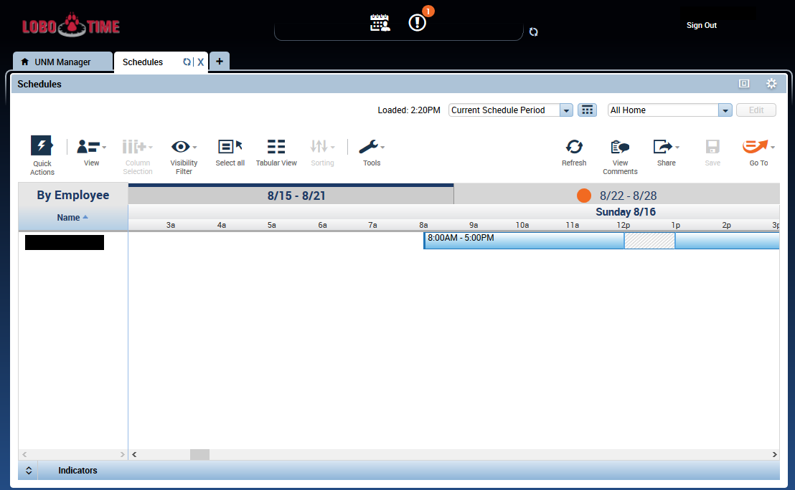
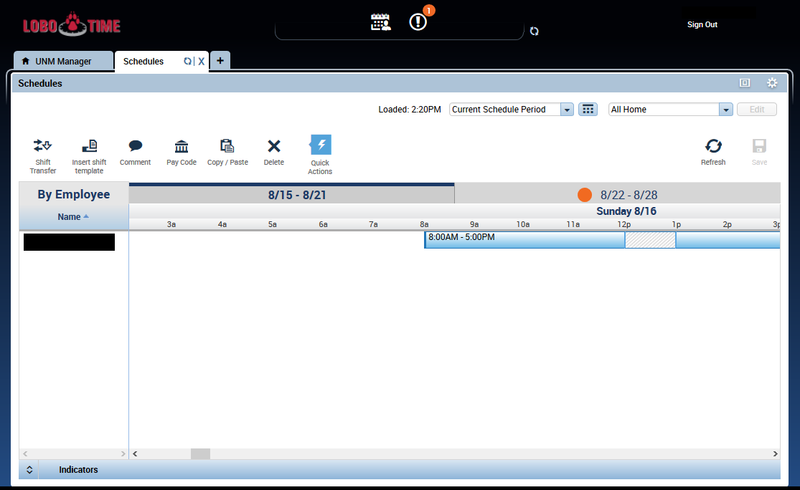
LoboTime v8.1.6 – Schedule Editor
Notes:
You can utilize the quick actions in the schedule tab to be able to insert shift templates quickly or you can also manually enter in their schedules here as well.

Slide 46
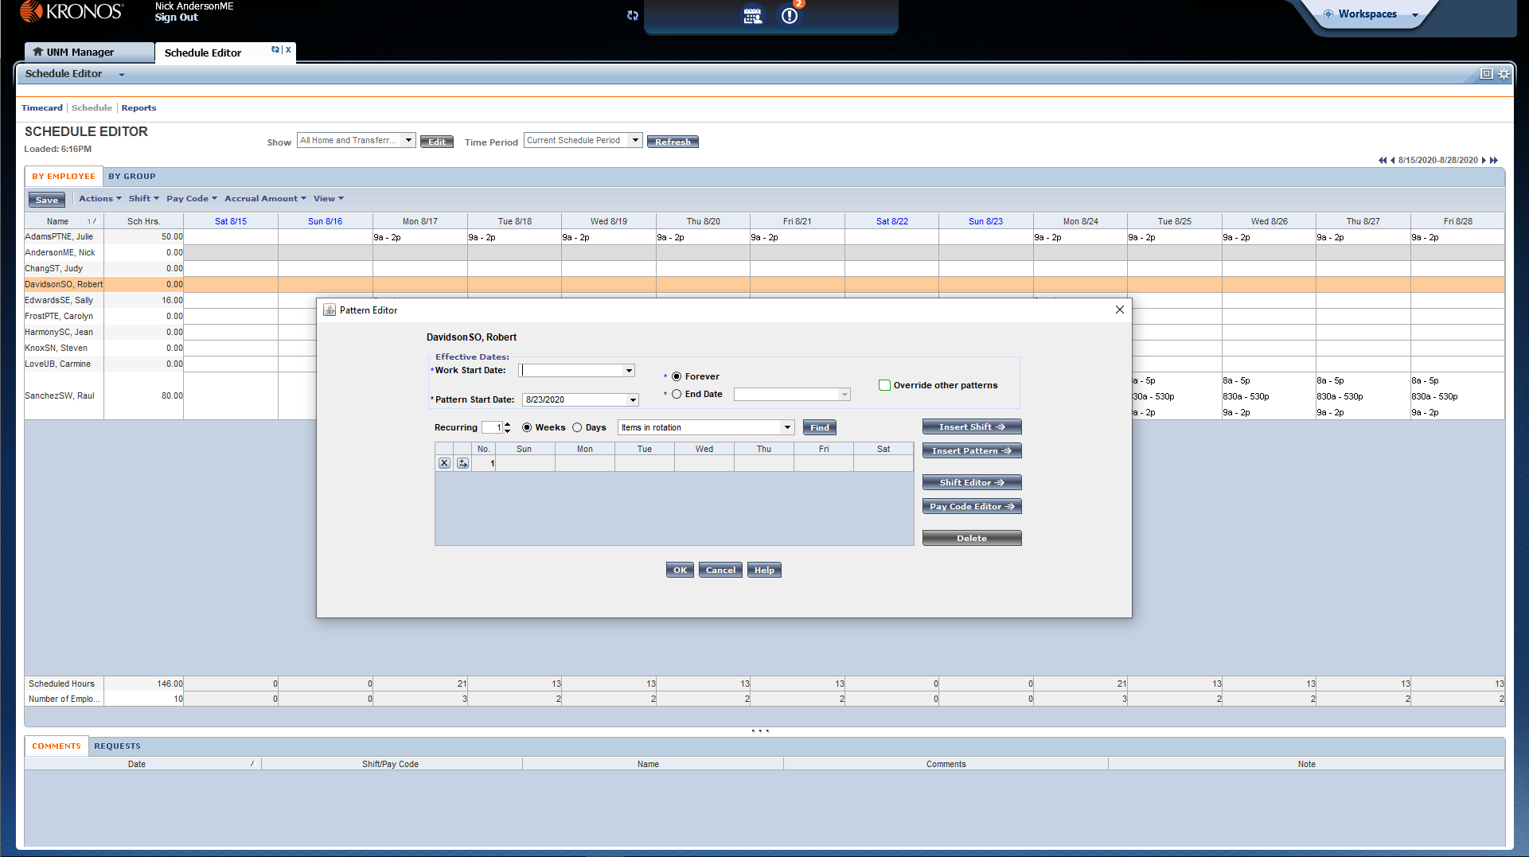
Current LoboTime – Schedule Pattern
Notes:
Here we will be comparing how to access schedule pattern, however, not much has changed.

Slide 47
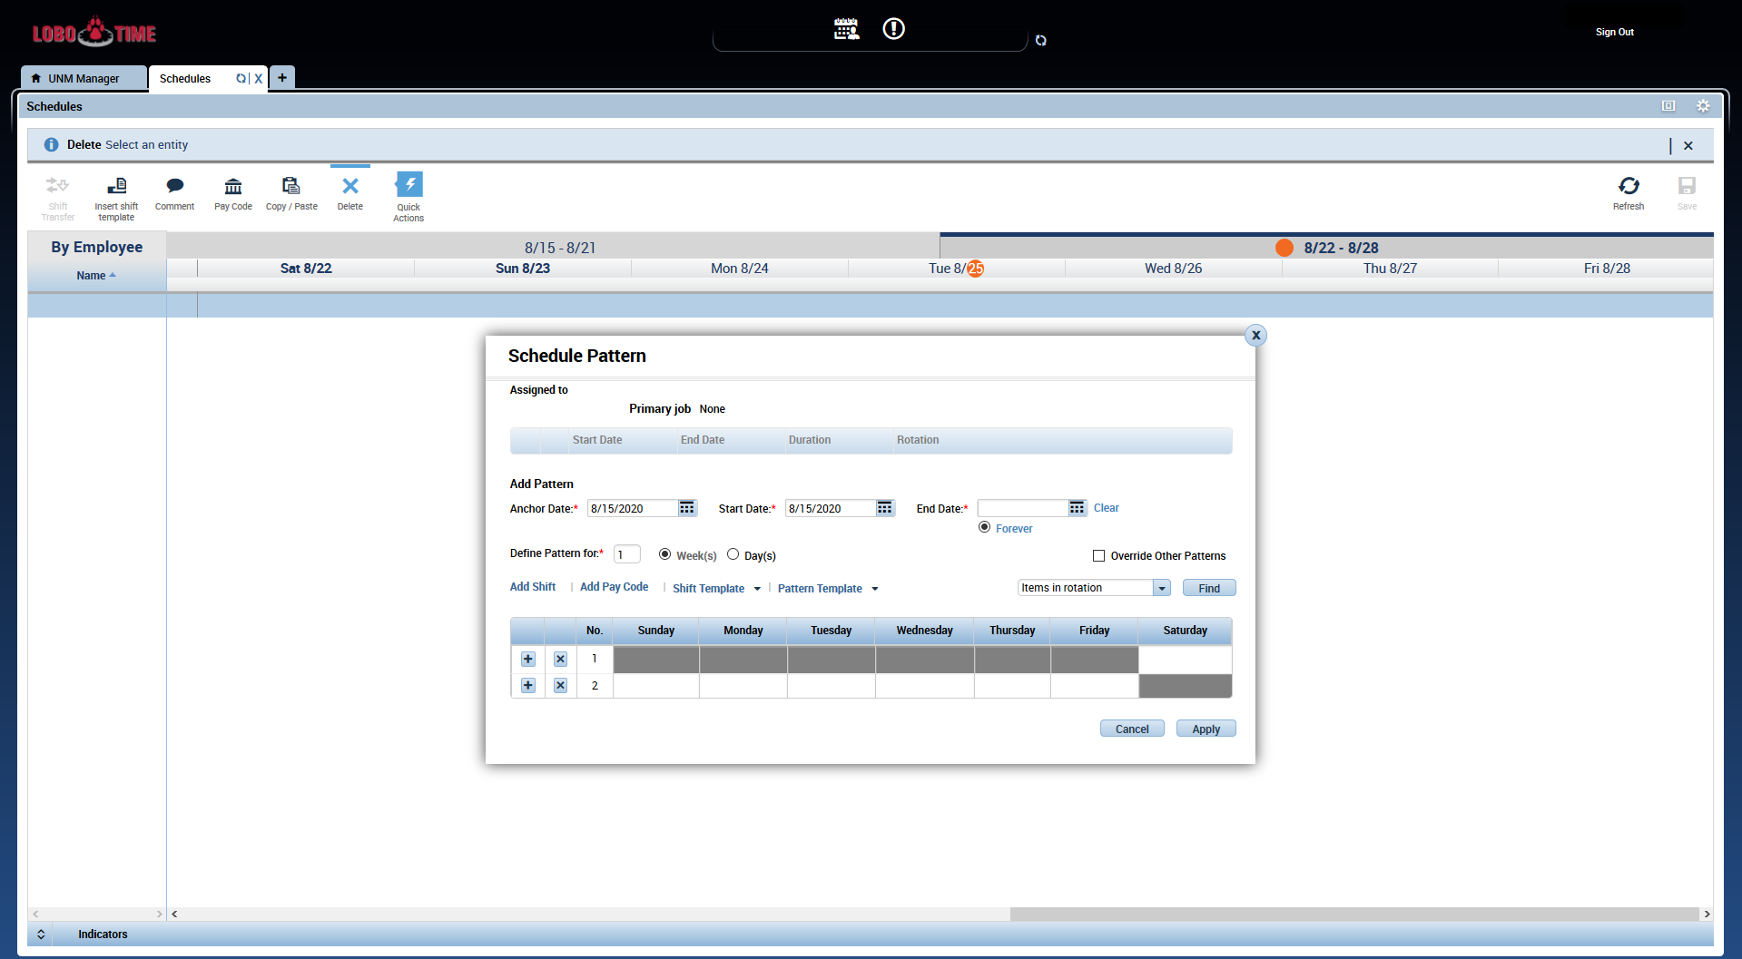
LoboTime v8.1.6 – Schedule Editor
Notes:
To set up repeating shift patterns you can right click on an employee’s name and select “Schedule Pattern” to be able to add in the repeating shift pattern that you need for your employees.

Slide 48
LoboTime v8.1.6 ”Move Amounts” Change
Notes:
There was a change with the “Move Amounts” function in our new version.
Most steps will not change, however, now you will need to go to an employee’s timecard and then scroll down to the Totals at the bottom of the page.
Change the dropdowns to be set to “Daily” and “All” for their respective drop downs.

Slide 49
LoboTime v8.1.6 – “Move Amounts” Change
Notes:
Like you see here

Slide 50
LoboTime v8.1.6 – “Move Amounts” Change
Notes:
Then right click on the day you want to move amounts and then right click the record in the totals area.

Slide 51
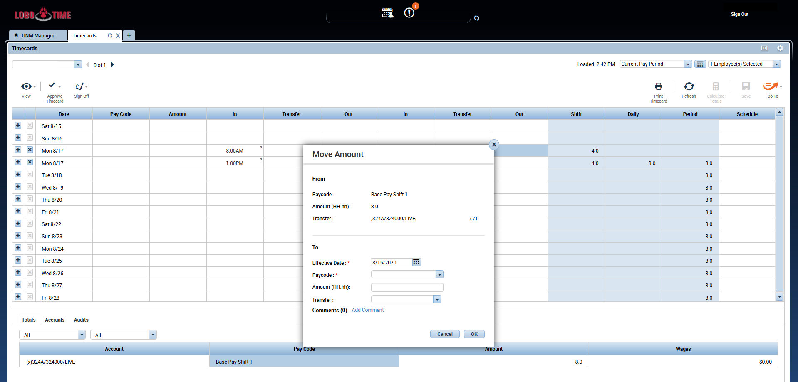
LoboTime v8.1.6 ”Move Amounts” Change
Notes:
Then follow the normal process to move the amounts.
Make sure the effective date is the correct date.
Select the correct paycode, amount to transfer, etc.and then save.

Slide 52
Current LoboTime - Sign Out

Slide 53
LoboTime v8.1.6 Sign Out

Slide 54
Test Cases
Provide a list of folks to Harold Chang (hchang01@unm.edu) that you would like to grant access so that you can run through some basic test cases of LoboTime.
Per LoboTime Agent/Department please provide one supervisor and two (one exempt and one non-exempt is ideal) employees you would like to have test in the new environment by EOB this Friday 8/28/20.
Please complete testing by 9/4/20 and report back your test case results
When testing please make sure to utilize Firefox or Chrome as the browser as this version of LoboTime is most compatible with these browsers.
Note: Our current instance of LoboTime is a copy from back in February so any changes since then have not been updated in our instance so when choosing employees please try to choose those who were your employees/managers before February to avoid issues when testing. Additionally, time clocks cannot be used for testing as they are being currently used so please make sure to select employees who can access/enter time on a PC.

Slide 55
LoboTime Assessment Project Survey
If you haven’t participated in the LoboTime Assessment Project survey or met with IT yet we highly encourage you to fill out this survey so that we can get your opinion on LoboTime.
Survey Link: https://esurvey.unm.edu/opinio/s?s=125703
Contact Kayla Abernethy at kabernethy@unm.edu for any questions.

Slide 56
Questions?

Slide 57
Links to Resources
HTML Navigator Webinar YouTube video: https://www.youtube.com/watch?v=WGe8kdY8BOQ
SharePoint Link with Documentation: https://unmm.sharepoint.com/:f:/t/it/apps/erpgov/ops/EmQpnKU9pJVBvWnWJzniz3oBQzVpCX5c18dicynExw6q3Q?e=cdCLT4

