Slide 1
LoboTime Common Tasks for Non-Exempt
PC Users Job Aid
The purpose of this job aid is to provide the common tasks for Non-Exempt PC Users of the LoboTime system.

Slide 2
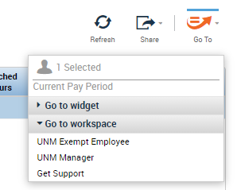
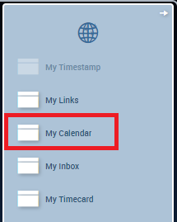
Common Tasks for Non- Exempt
Employees
Logging Off of LoboTime
Logging On to LoboTime
Access the LoboTime log on page.
Click the Log Off utility link in the banner. LoboTime returns to the Workforce Central log on page.
Type your Net ID and password in the designated fields.
Click on the arrow button to Log On
Caution: Clicking the Close (X) button without first logging off can leave your connection to LoboTime open, which might allow unauthorized people to view and edit information.
Overview of LoboTime Non- Exempt
Active Bar
Displays active workspaces; click title to bring a workspace into focus.
Workspace Container for one or more workspaces
Name / Sign Out
Identifies user and a link to sign out of LoboTime.
Related Items Pane
Includes one or more additional widgets for less common tasks.
Activating Widgets
After recording time stamp, single click on any widget in the Related Items pane to activate in the workspace.
Workspace Tabs
Each active workspace gets its own tab. You can switch back and forth between workspaces by selecting the tab you want to view. You must always have at least one workspace open, but you can close any additional workspaces by hovering over its tab and clicking the Close (X) button.

Slide 3
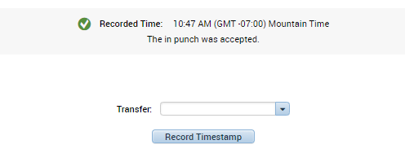
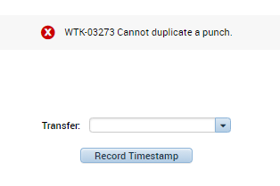
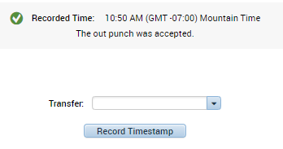
Possible System Responses:
Recording Your Time
Click the Record Time Stamp button.
The time recorded by the system will display.
Duplicate Punch
Employee attempts to punch in/out a second time. System will alert and not allow a duplicate punch
Successful Out Punch
Employee punches out to end shift. System will display successful record of punch
If Punch is made in error, contact your Lobo Time Agent for assistance to resolve issue.

Slide 4
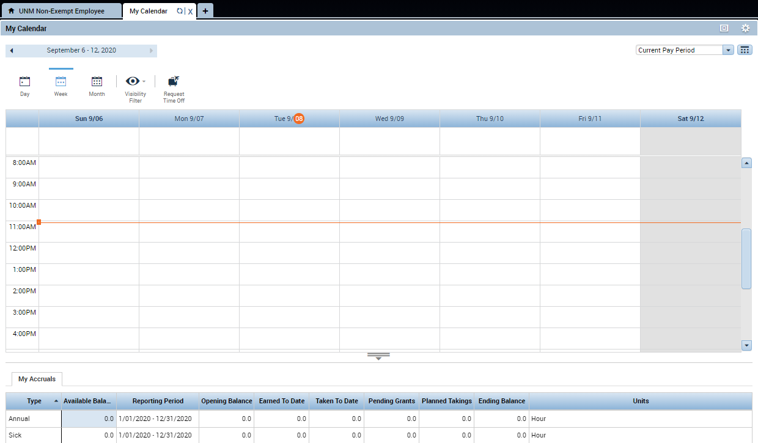
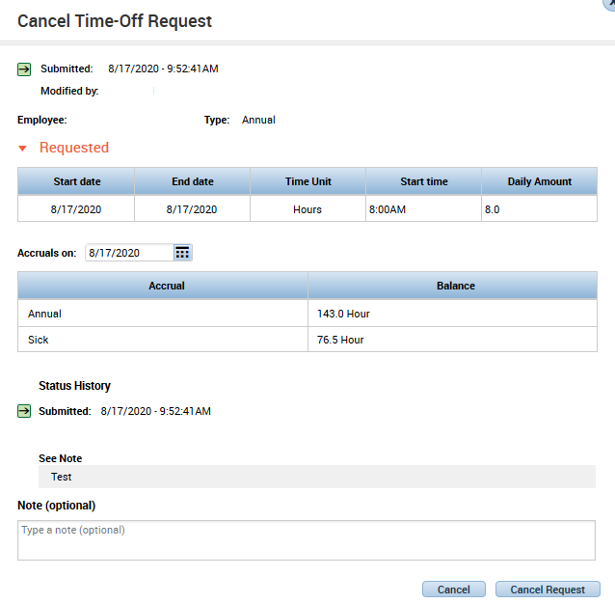
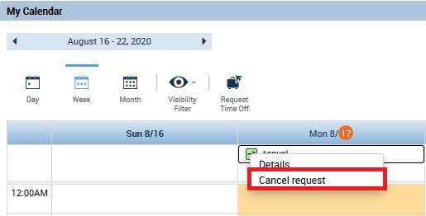
Common Tasks for Non-Exempt
Employees
Requesting Time Off
Activate the My Calendar tab from the Related Items pane.
Confirm the selected Start Date and End Date. Change the date if required.
Select the date that you want to request time off for.
Make sure that the “Time Unit” is set to hours.
Select the Request Time Off icon.
Enter a Start Time for the time off request (add am or pm).
From the Requests list, select the appropriate time off request – Annual or Sick
In the Daily Amount field, input the daily amount of hours that leave will be for.
In the Notes box, add notes for the request and then click submit.
Retracting a Time Off Request
Add a note to detail leave cancellation.
Access the My Calendar and find the date of the leave request you would like to retract.
Click Cancel Request and then verify in the leave details that the cancel leave request has been submitted.
Right-click the leave request and then select “Cancel Request."
A pop up should appear and should have the leave information you submitted.

Slide 5
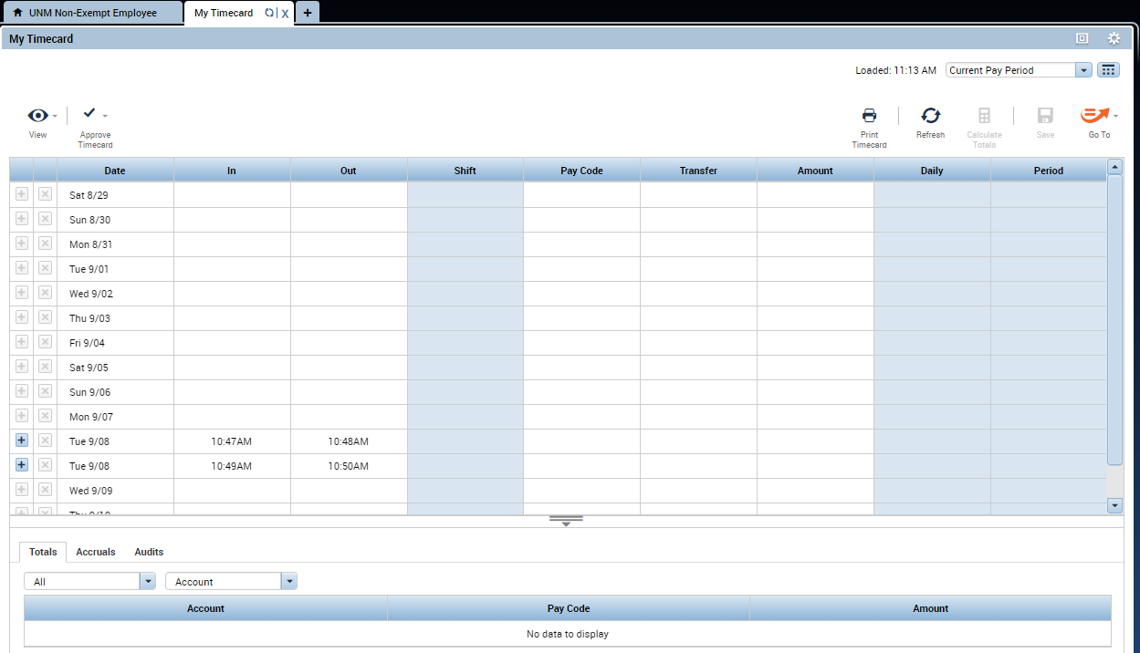
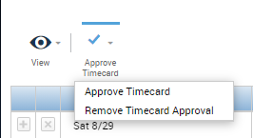
Common Tasks for Non-Exempt
Employees
Viewing Your Timecard
Access the My Timecard widget from the Related Items
pane.
At the top of the timecard, use the drop down arrow to select the time period you wish to view.
Note: Your timecard displays your timestamps, non-worked time and total hours. Times with a red, yellow, or green bar, have an exception such as late in. Hover over the bar to view additional details about the exception.
Approving Your Time
Access the My Timecard widget from the Related Items
Pane.
Select the “Approve Timecard” icon. A notification message will appear showing approval or removal of approval. Additionally, the audit tab at the bottom will contain information about the sign-offs as well.
Note: You can remove your approval by following the same steps and selecting Remove Approval from the Approve Timecard menu.
Issues with Time Card and Punches
For any issues regarding the time card and/or punches, please contact your LoboTime Time Manager or Supervisor for assistance and troubleshooting.

