Slide 1
LoboTime Agent Training Kit

Slide 2
Purpose of LoboTime Agent Training Kit:
The purpose of this kit is to provide the LoboTime Agent with the tools and resources necessary for you to effectively train your department employees who will be filling their timecards electronically in LoboTime. This kit can be used for ongoing training as department needs arise and staffing changes occur.

Slide 3
Contents of LoboTime Agent Training Kit:
Common definitions in LoboTime
Schedule of training courses for Time Manager/Supervisor
List of training courses descriptions for employee and Time Manager/Supervisor
Defined roles and responsibilities
Best practices for implementation and after go-live
Next steps

Slide 4
LoboTime Definitions:
Workforce Timekeeper (WTK) = Kronos term used to describe the
application at UNM. Kronos Workforce Timekeeper is LoboTime
LoboTime Agent = Main point of contact at the organization, responsible for
rolling out training for the employees using PC and/or Time clocks
LoboTime Time Manager* = This role allows the individual to see their whole organization including supervisors and employees
LoboTime Supervisor* = This role allows the individual to see the employees for whom they are listed as the supervisor on file in the Banner system
*The roles will be referred to as Time Manager/Supervisor in the rest of the kit

Slide 5
Role & Responsibilities of LoboTime Agent
Designated as the single point of contact for all LoboTime
communication. Responsible for seeing that all Time
Managers/Supervisors, and employees receive
necessary communications
Responsible for ensuring that all Time Managers/Supervisors
take required instructor led training and required
prerequisites
Responsible for review and communicating University Business
Policy – 2000 Responsibility and Accountability for University
Information and Transactions

Slide 6
Role & Responsibilities of LoboTime Agent continued
Responsible for ensuring that all employees who are required to clock in or time stamp via a PC are trained and receive needed support
Handle approval of all BAR requests for Time Manager/Supervisors
within their organizations
Responsible to deliver employee training for all newly hired or transferred employees
Function as a liaison for the Time Managers/Supervisors and employees
Responsible for communicating upgrades, enhancements, and process
changes to department

Slide 7
Best Practices for LoboTime Agents to consider implementing

Slide 8
Recommend Business Practices – Business Process
For the Time Managers/Supervisors - define:
Roles/expectations of the Time Manager/Supervisor
How often to review exceptions and leave requests
What are the established deadlines for approval
When approvals must be completed
When sign-offs must be completed

Slide 9
Recommend Business Practices – Business Process
For the Employee - define:
Which system will be used pc and/or time clock
Check system daily to review punches
How to request leave (sick or annual)
What is the time card approval process
What are the deadlines for approval
What is the process for fixing errors and/or mistakes
Expectation for meal punches (policy, union contract)
What is the process for new employees
What are the department expectations regarding policy
(e.g. not sharing cards – clocking in someone else)

Slide 10
Recommend Business Practices - System
Determine who is responsible for inputting schedules
Establish the expectation for comment/notes for documenting information both for employee and Time Manager/Supervisors
System Requirement
Time Managers/Supervisors must fix missing punches, approve, and
signoff all timecards by 5pm on the Monday evening prior to Payroll
run

Slide 11
Recommend Business Practices – Time clock
Determine best practices in the organization for the use of
time clock functionality including:
Restricting terminal access during peak time for functions other than clocking in/out
Clearly designate and document what clock(s) your employees should be using to clock in
Clearly define the process of how to handle errors if they occur
Define what guidelines apply to using another clock

Slide 12
Recommend Business Practices – PC user
Determine best practices in the organization for the use of
PC user including:
Clearly designate what pc(s) your employees should be using to clock in
Clearly define the process of how to handle errors if they occur
Define what guidelines apply for using another PC location

Slide 13
Recommend Business Practices continued
Encourage Time Managers/Supervisors to check punches daily
at go-live
If timecard is approved by employee and a change needs to happen,
Time Manager/Supervisor should communicate changes back to
employee and document inside of LoboTime system
For new employees – who can not use system, determine what is process to capture time

Slide 14
Roll out Strategy LoboTime

Slide 15
Roll out strategy for LoboTime agents- phase one
12 weeks to 10 weeks out
Attend LoboTime Agent training
Request BAR role (when available)
Communicate prerequisites for training
Develop training plan for your
organization**
Communicate training plan
to your organization
**Important to create the plan with the organizational calendar

Slide 16
Roll out strategy for LoboTime agents- phase one
10 weeks to 8 weeks out
Ensure Time Managers/Supervisors
sign up and attend LoboTime
training class
Determine internal business practices
for time clock/pc users
A report will be forwarded to the
LoboTime Agent to track completion

Slide 17
Roll out strategy- phase one
8 weeks to 6 weeks out
Audit/track Time Managers/Supervisors
attendance to ensure completion
Reinforce/communicate internal business
practices for time clock/pc users
Begin department training for
time clocks and pc users

Slide 18
Roll out strategy- phase one
6 weeks to 4 weeks out
Continue training for time clock/pc users
Continue to audit/track Time Managers/
Supervisors attendance in training
course
Attend open lab sessions to practice
entering schedules and performing
functions in the LoboTime system

Slide 19
Roll out strategy- phase one
4 weeks out to go-live
Complete readiness check with organization
Complete readiness check with LoboTime Agents
Final trainings for employees will occur
Check-in with LoboTime Managers
Supervisors for readiness check

Slide 20
Learning Central overview

Slide 21
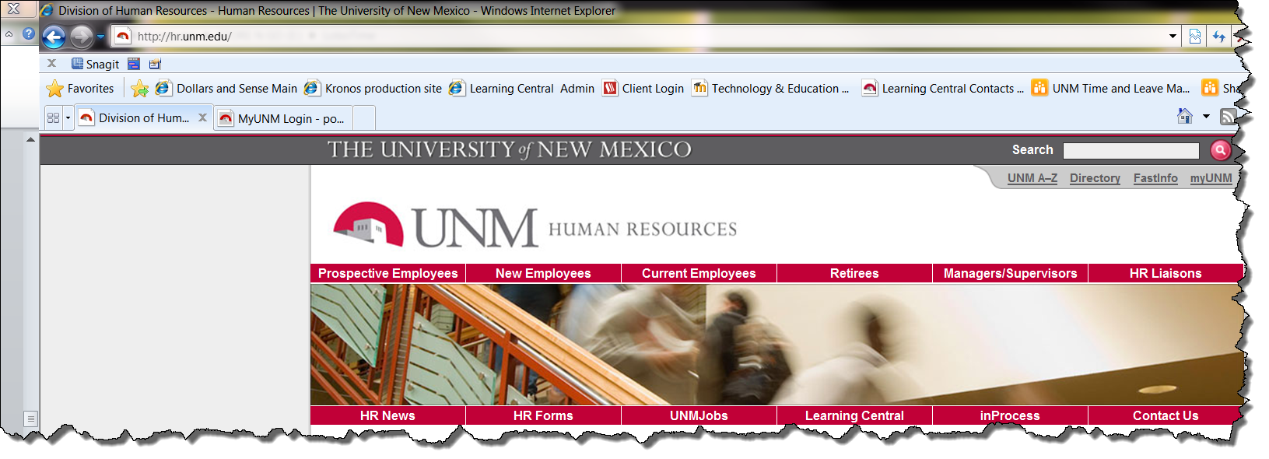
Learning Central view:
From HR website, select Learning Central

Slide 22
Learning Central view:
Log into Learning Central using UNM Ned ID and password

Slide 23
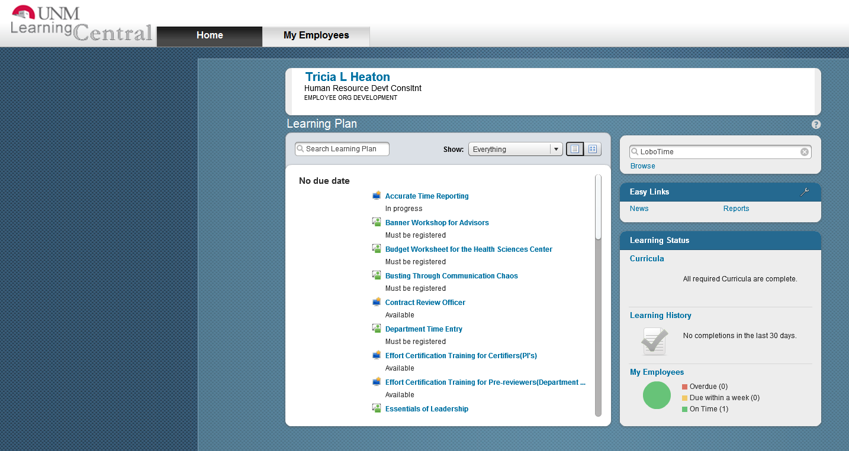
Learning Central view:
LoboTime
Enter “LoboTime” in search field

Slide 24
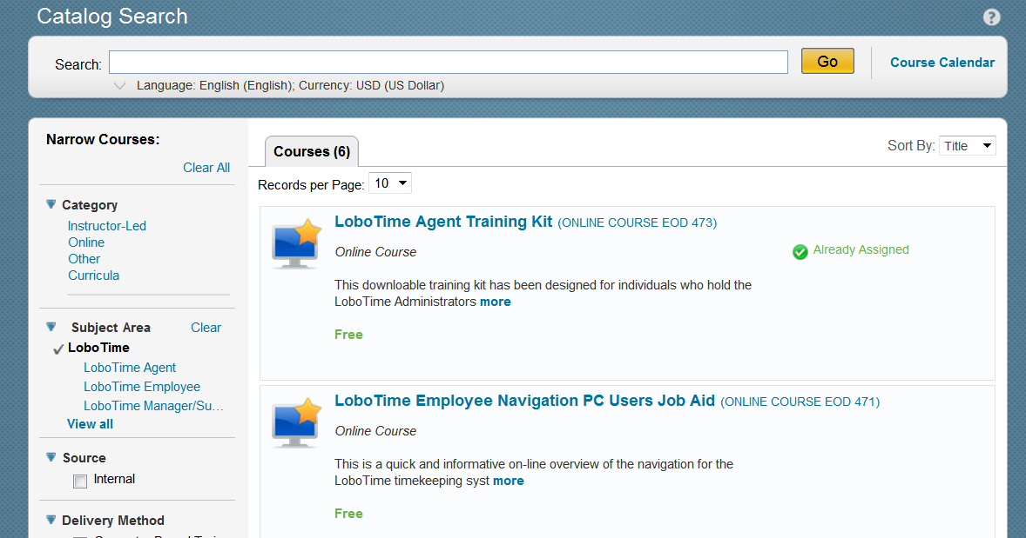
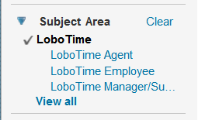
LoboTime will have three subject areas available: LoboTime Agent, LoboTime
Employee, and LoboTime Time Manager/Supervisor. Depending on type of employee
select appropriate subject area. Within each subject area, the different course/job aids are
available

Slide 25
Description of courses/job aids:
Class Name: | Description:
LoboTime Time Manager/Supervisor training | This instructor led training is required for individuals who will be responsible for LoboTime timekeeping system in either a Time Manager/Supervisor role
LoboTime Navigation Online course | This short online tutorial for the employee or Time Manager/Supervisor using a PC will provide an overview of functionality and navigation in the LoboTime timekeeping system
LoboTime Employee Navigation PC user Job Aid | This is a supplemental job aid for the employee navigation online tutorial for the LoboTime timekeeping system
LoboTime Manager Navigation PC user Job Aid | This is a job aid to supplement the Time Manager/ Supervisor navigation online tutorial
LoboTime Agent Training Kit | This training kit has been designed for individuals who hold the LoboTime Agent role. This training includes information on roles and responsibilities, role out strategy, and additional training information for end users
LoboTime Common Tasks for PC Users Job Aid | This is a job aid for the employee or Time Manager/Supervisor who will be using the PC to log in and out, time stamp, and request time off
LoboTime Employee Time Clock Job Aids: In Touch and Terminal | These are supplemental job aids for the employee user who will be using the time clock function to perform common tasks in the LoboTime timekeeping system. Two time clock job aids exists: In Touch and Terminal
LoboTime Manager Time Clock Job Aids: In Touch and Terminal | These are supplemental job aids for the role of Time Manager/Supervisor who will be using the time clock function to manage inside the LoboTime timekeeping system . Two time clock job aids exists: In Touch and Terminal

Slide 26
Workflow training - Time Manager/Supervisor

Slide 27
Workflow training - Time Manager/Supervisor
Communicate the following to your Time Manager/Supervisors:
Process to request BAR roles
Sign up and attend instructor led training Time Manager/Supervisor training course (EOD 470) which has prerequisites:
- Securing Private Data and Exam (FINPRV102)
- Accurate Time Reporting for Managers and Acknowledgement (EOD-FLSA)
Download and review the navigation CBT & job aid
Download and review the Time clock job aids for managers (In touch and Terminal)

Slide 28
Workflow training - Time Manager/Supervisor
Navigation
CBT Manager

Slide 29
Workflow training - Time Manager/Supervisor
Time clock
Soft Keys Touchscreen

Slide 30
Workflow training - Employee

Slide 31
Workflow training - Employee
Communicate the following to your Employee:
Download and review navigation job aid
Download and review PC user job aid
Download and Time clock job aids (InTouch and Terminal)

Slide 32
Workflow training -Employee
Navigation
CBT PC Users Job Aid PC Users

Slide 33
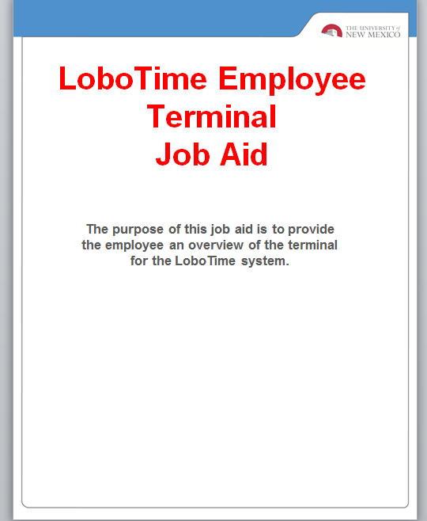
Workflow training- Employee
PC User Time Clock
Soft Keys Touchscreen

Slide 34
Next Steps
Take this information back to your organization and
communicate status of project to your organization
Work with your Leadership team to determine the
recommended business practices and expectations
that will support the implementation including
structure of Time Managers/Supervisors
Discuss timeline with your organization
During open lab time/parallel preview create schedule for both exempt and non-exempt employees

Slide 35
Next Steps continued:
Ask LoboTime Managers/Supervisors to enroll in
LoboTime Instructor led course.
As of Friday, August 10th, access Learning Central
to download job aids for your employees.
With your Leadership team, develop training plan with
time frame to roll out time clock/pc user training
to your employees.

Slide 36
Future expectations
Determine the process for new employees and create
on-going training plan
Determine how to handle a change in LoboTime agent
(BAR impact)
Ongoing communication to organization

Slide 37
For on-going updates/support:
Visit: LoboTime.unm.edu
For Support: Contact Payroll at 277-2353
Email: Pay@unm.edu

Slide 38
Appendix:
Training Prerequisites
Securing Private Data and Exam (FINPRV102)
Accurate Time Reporting for Managers and
Acknowledgement (EOD-FLSA)
Training Schedule

Slide 39
Training Schedule
Title of course: | LoboTime Time Manager/Supervisor training
Course Number: | EOD 470
Date: | Location: 1019
 | Time:
9-Aug | 8:30 a.m. - 12:30 p.m. | 1:00 - 5:00 p.m.
10-Aug | 8:30 a.m. - 12:30 p.m. | 1:00 - 5:00 p.m.
13-Aug | 8:30 a.m. - 12:30 p.m. | 1:00 - 5:00 p.m.
15-Aug |  | 1:00 - 5:00 p.m.
16-Aug | 8:30 a.m. - 12:30 p.m. | 1:00 - 5:00 p.m.
20-Aug | 8:30 a.m. - 12:30 p.m. | 1:00 - 5:00 p.m.
22-Aug | 8:30 a.m. - 12:30 p.m. | 1:00 - 5:00 p.m.
Date: | Location: Med Lab 2
8-Aug | 8:30 am - 12:30 p.m. | 1:00 - 5:00 p.m.
9-Aug | 8:30 am - 12:30 p.m. | 1:00 - 5:00 p.m.
10-Aug |  | 1:00 - 5:00 p.m.
14-Aug | 8:30 am - 12:30 p.m. | 1:00 - 5:00 p.m.
15-Aug | 8:30 am - 12:30 p.m. | 1:00 - 5:00 p.m.
16-Aug | 8:30 am - 12:30 p.m. | 1:00 - 5:00 p.m.
17-Aug | 8:30 am - 12:30 p.m. | 1:00 - 5:00 p.m.
21-Aug |  | 1:00 - 5:00 p.m.
22-Aug | 8:30 am - 12:30 p.m. | 1:00 - 5:00 p.m.

